Slide 1
FINAL PROJECT
People counting and tracking based on LIDAR data
SURENDER SAMPATH
MSc Internet Of Things
Department of School of Electronic Engineering and Computer Science

Slide 2
SECTIONS
INTRODUCTION
CONCEPTS
IMPLEMENTATION
EVALUATION
DEMONSTRATION
CONCLUSION

Slide 3
INTRODUCTION

Slide 4
OVERVIEW
Indoor localisation is a concept of knowing the exact position of the people and objects where satellite technologies fail to work in places like multi-storey building and undergrounds.
Applications:
Location based Ads
Indoor Navigation
Augmented reality
Self driving robots
Asset tracking
Patient Rehabilitation
Hotel room security
Activity classification

Slide 5
OVERVIEW
Commonly used technologies in indoor positioning system are :
Wi-Fi
WAP
Bluetooth
Camera
Principle : These technologies were based on the principle of RSSI(Received signal strength Indicator).
DISADVATAGES:
Radio Interference
Poor Accuracy(metres)
Requirement to wear on body sensors(except camera).

Slide 6
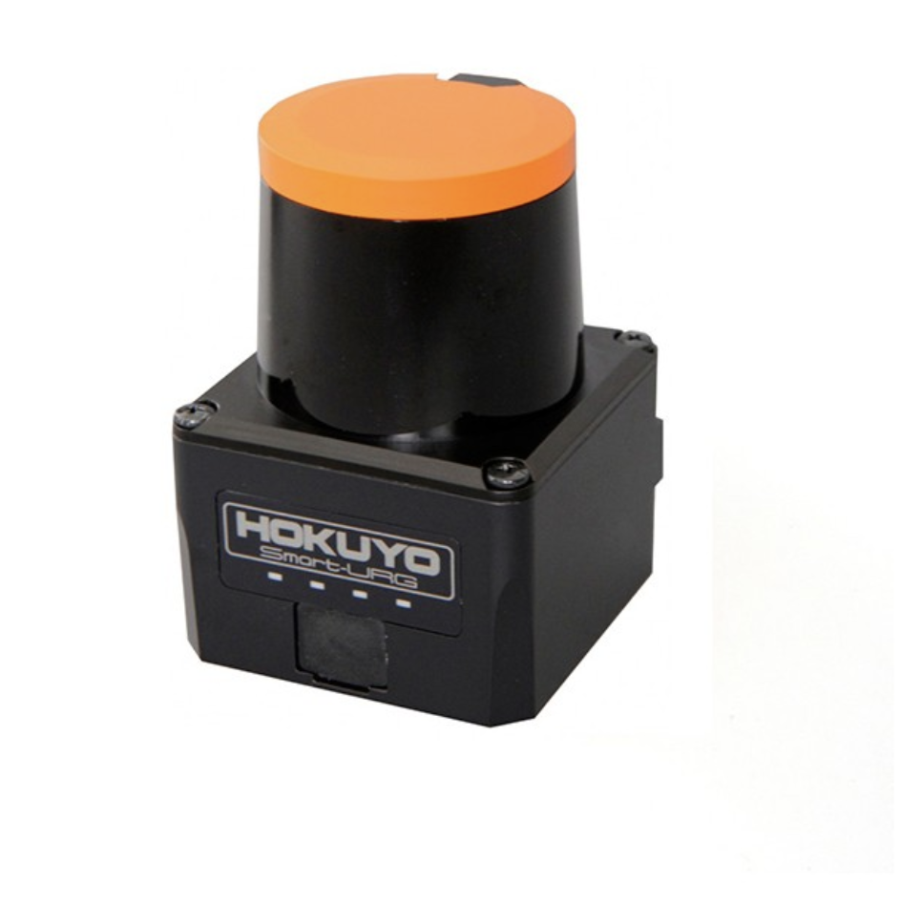
OVERVIEW
This project proposes an alternative solution of using LIDAR.
ADVANTAGES :
Ultrawideband device – No communication interference.
No need of on body sensors.
Accuracy within cms.
Reasons for choosing HOKUYO LIDAR:
2D
Popular among robotic applications.
Works in diverse operating conditions.
Laser sensing is computationally feasible.

Slide 7
OBJECTIVE
The objective of the project is to create an application to detect and count the number of humans present in the kitchen environment using LIDAR as a sensor of measurement.
AIM:
Use real-world data to train the supervised machine learning model for human detection.
To successfully track multiple people, present in the environment.
To successfully count the number of people, present without occlusion.

Slide 8
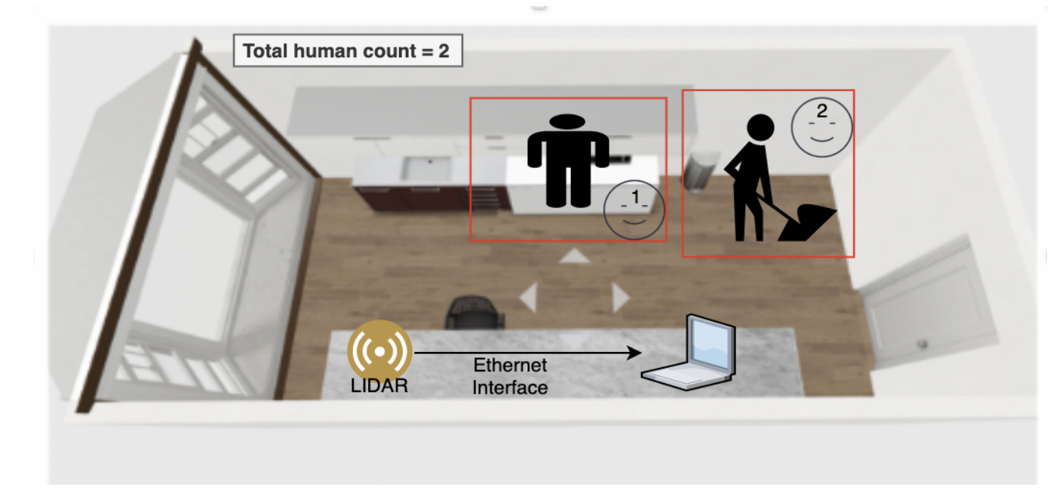
SYSTEM OVERVIEW

Slide 9
CONCEPTS

Slide 10
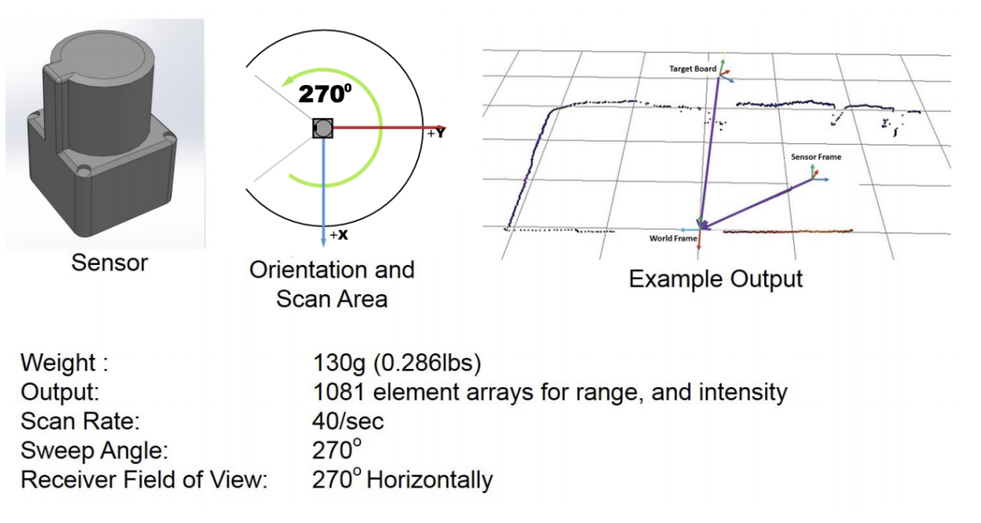
WORKING OF LIDAR
LIDAR emits light at the surface and measures the time taken for it to reflect back.
Time taken by the light signal to bounce back is used calculate the distance of the object.

Slide 11
DBSCAN CLUSTERING ALGORITHM
A non parametric clustering algorithm known for its ability to identify noise. Density-based spatial clustering of applications with noise (DBSCAN).
KEY POINTS:
DBSCAN does not require number of clusters as parameter.
MinPts – Number of minimum points required to form a cluster.
ε Radius – All points fall within the radius forms a cluster.
More suitable than K-Means to this project.

Slide 12

RANDOM FOREST CLASSIFER
A tree-based ensemble classifier that fits several decision trees on given categories of data. The fundamental concept is the wisdom of trees.
KEY POINTS:

Slide 13
IMPLEMENTATION

Slide 14
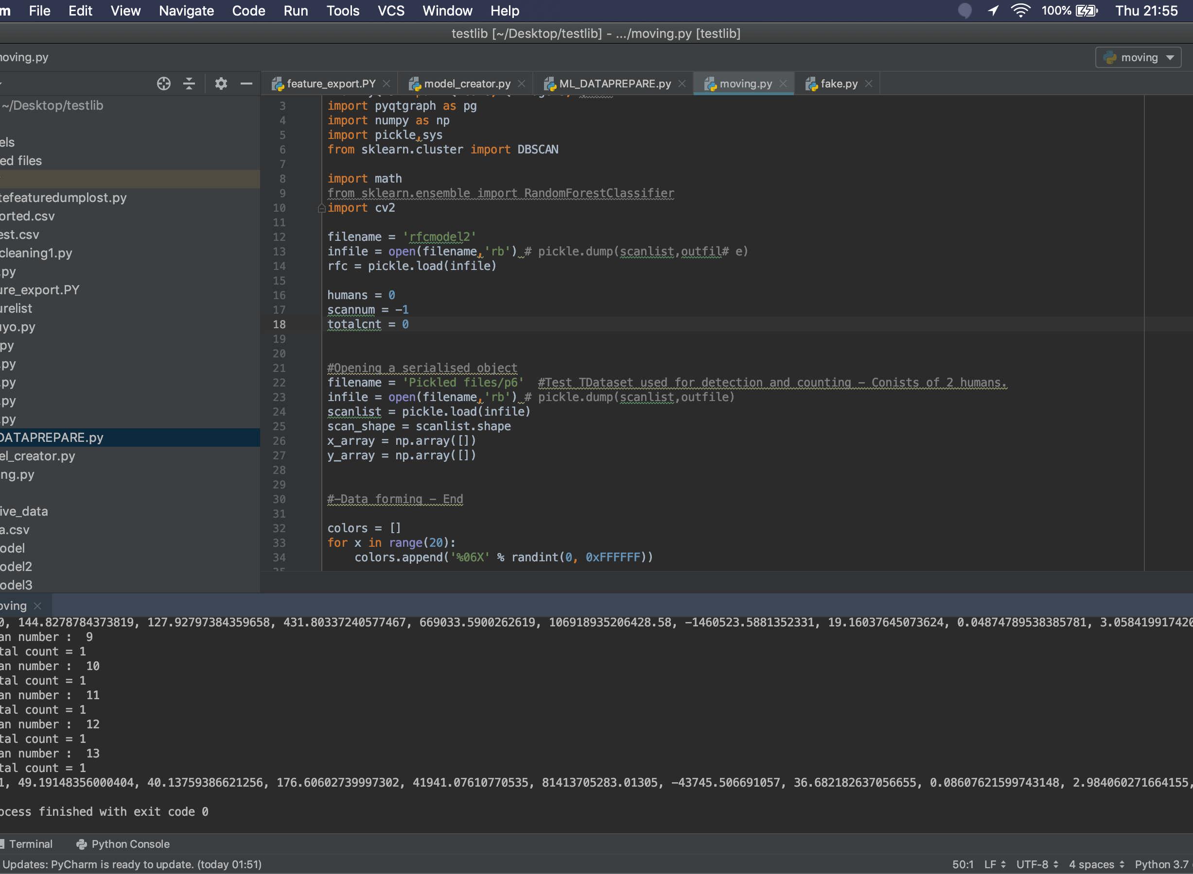
IMPLEMENTATION
The implementation of the project is divided into three segments.
2.TRAINING THE MACHINE LEARNING MODEL
1.DATA WRANGLING
3.DETECT AND DISPLAY HUMAN COUNT
.

Slide 15
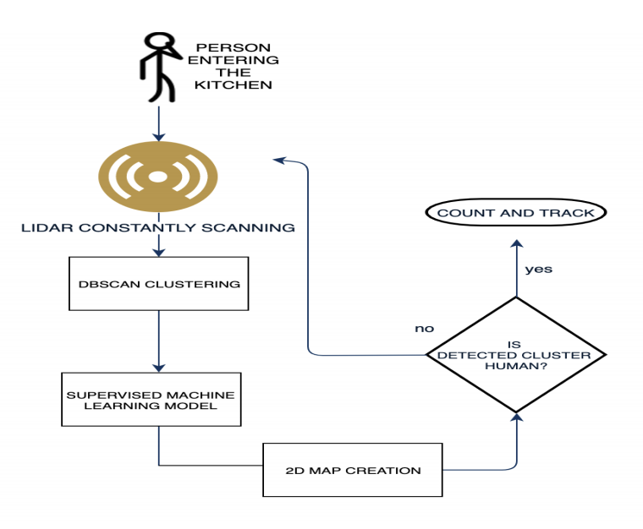
IMPLEMENTATION FLOWCHART

Slide 16
1.DATA WRANGLING
A process of transforming raw data into another format that is more appropriate for usage in the later part of the application.
STEPS INVOLVED:
All positive and negative samples are collected from the sensor via Ethernet Interface.
Collected datasets are converted into 2D Array using numpy.
The created 2D array is clustered using DBSCAN.
A set of 14 features is extracted from each cluster.

Slide 17
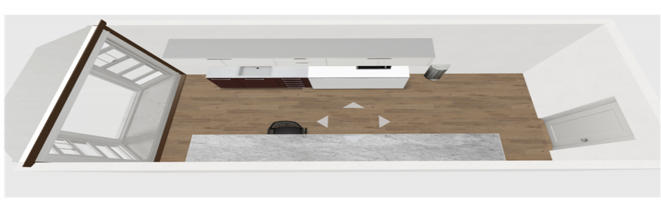
1.DATA WRANGLING
GRAPHICAL REPRESENTATION OF THE KITCHEN

Slide 18
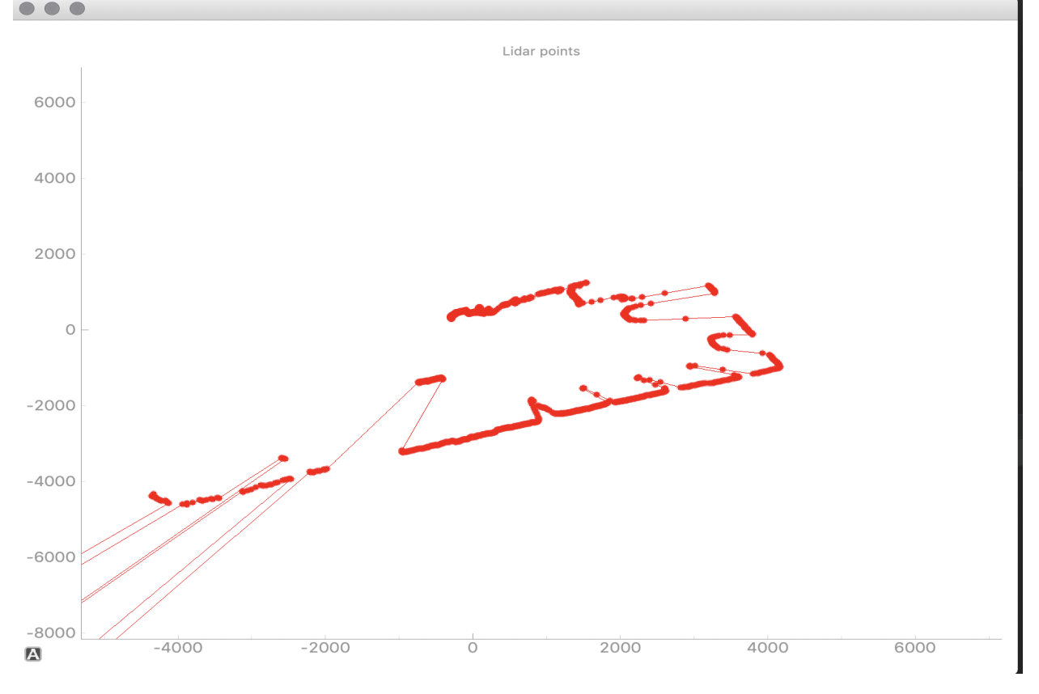
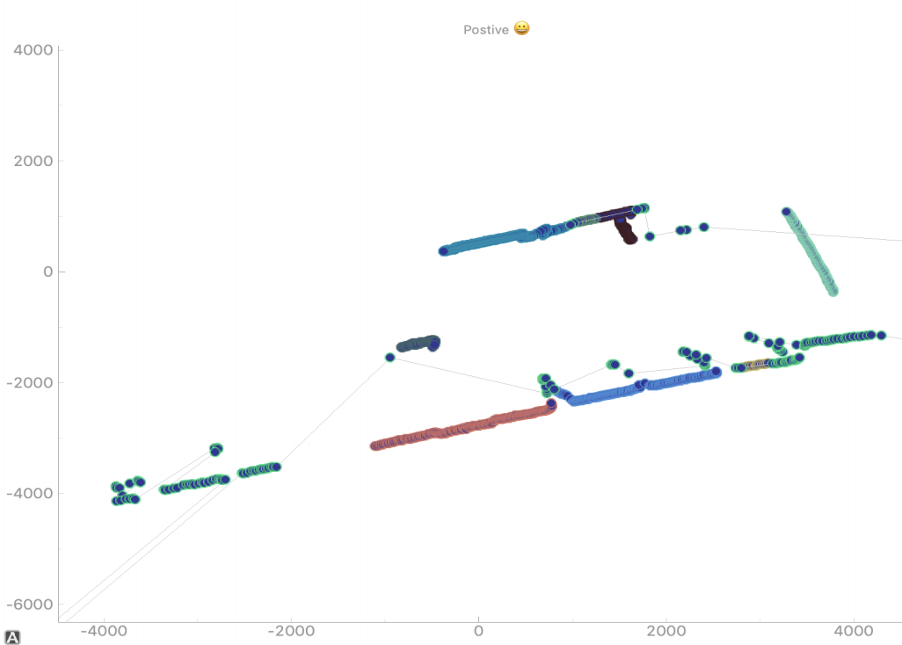
1.DATA WRANGLING
BEFORE CLUSTERING
AFTER CLUSTERING

Slide 19
2.TRAINING THE MACHINE LEARNING MODEL
STEPS INVOLVED:
Collect the positive samples.
Collect the negative samples.
Categorise positive cluster feature samples as 1.
Categorise negative cluster feature samples as 0.
The derived 14 features from the clusters is fed to the model.

Slide 20
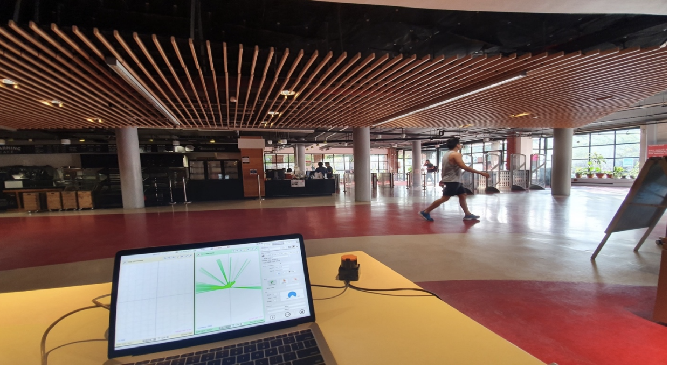
2.TRAINING THE MACHINE LEARNING MODEL
DATA COLLECTION SETUP

Slide 21
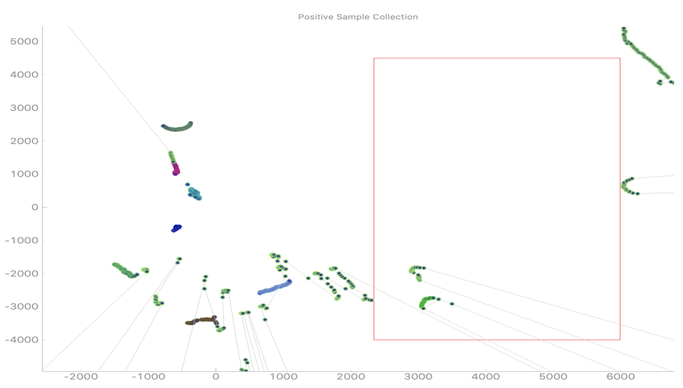
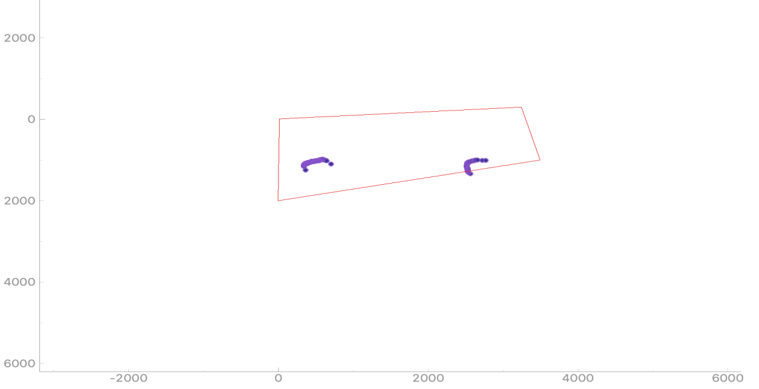
2.TRAINING THE MACHINE LEARNING MODEL
VIRTUAL PERIMETER SETUP TO COLLECT POSITIVE SAMPLES

Slide 22
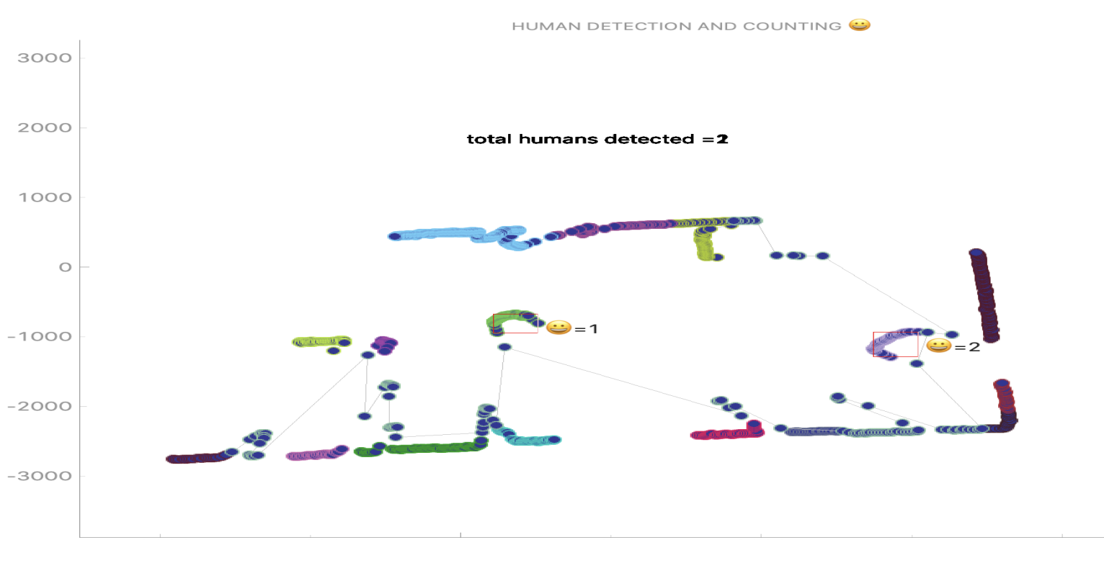
3.DETECT AND DISPLAY THE HUMAN COUNT

Slide 23
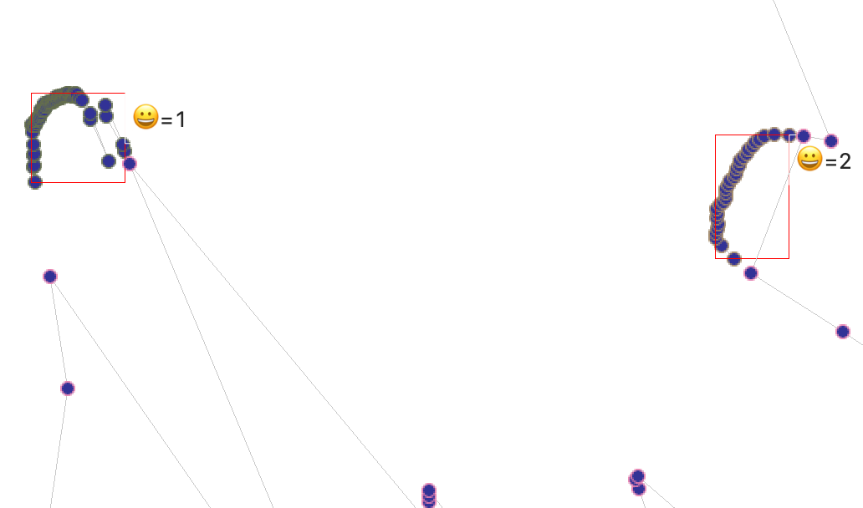
3.DETECT AND DISPLAY THE HUMAN COUNT

Slide 24
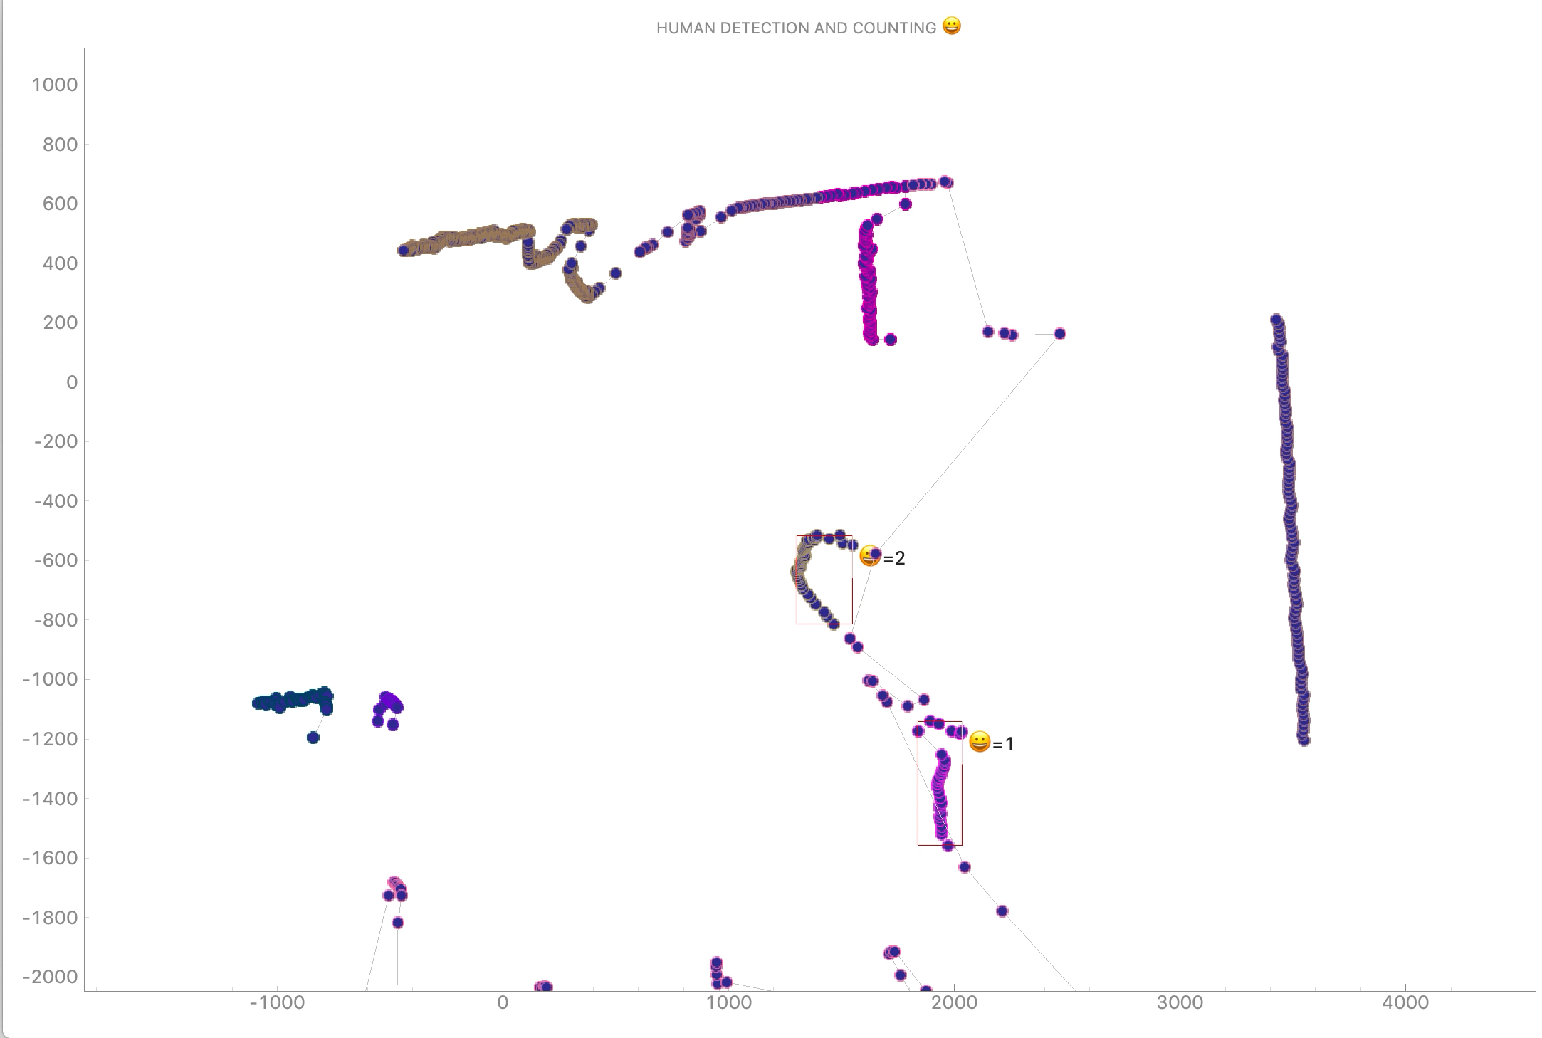
3.DETECT AND DISPLAY THE HUMANCOUNT - VIDEO

Slide 25
EVALUATION

Slide 26
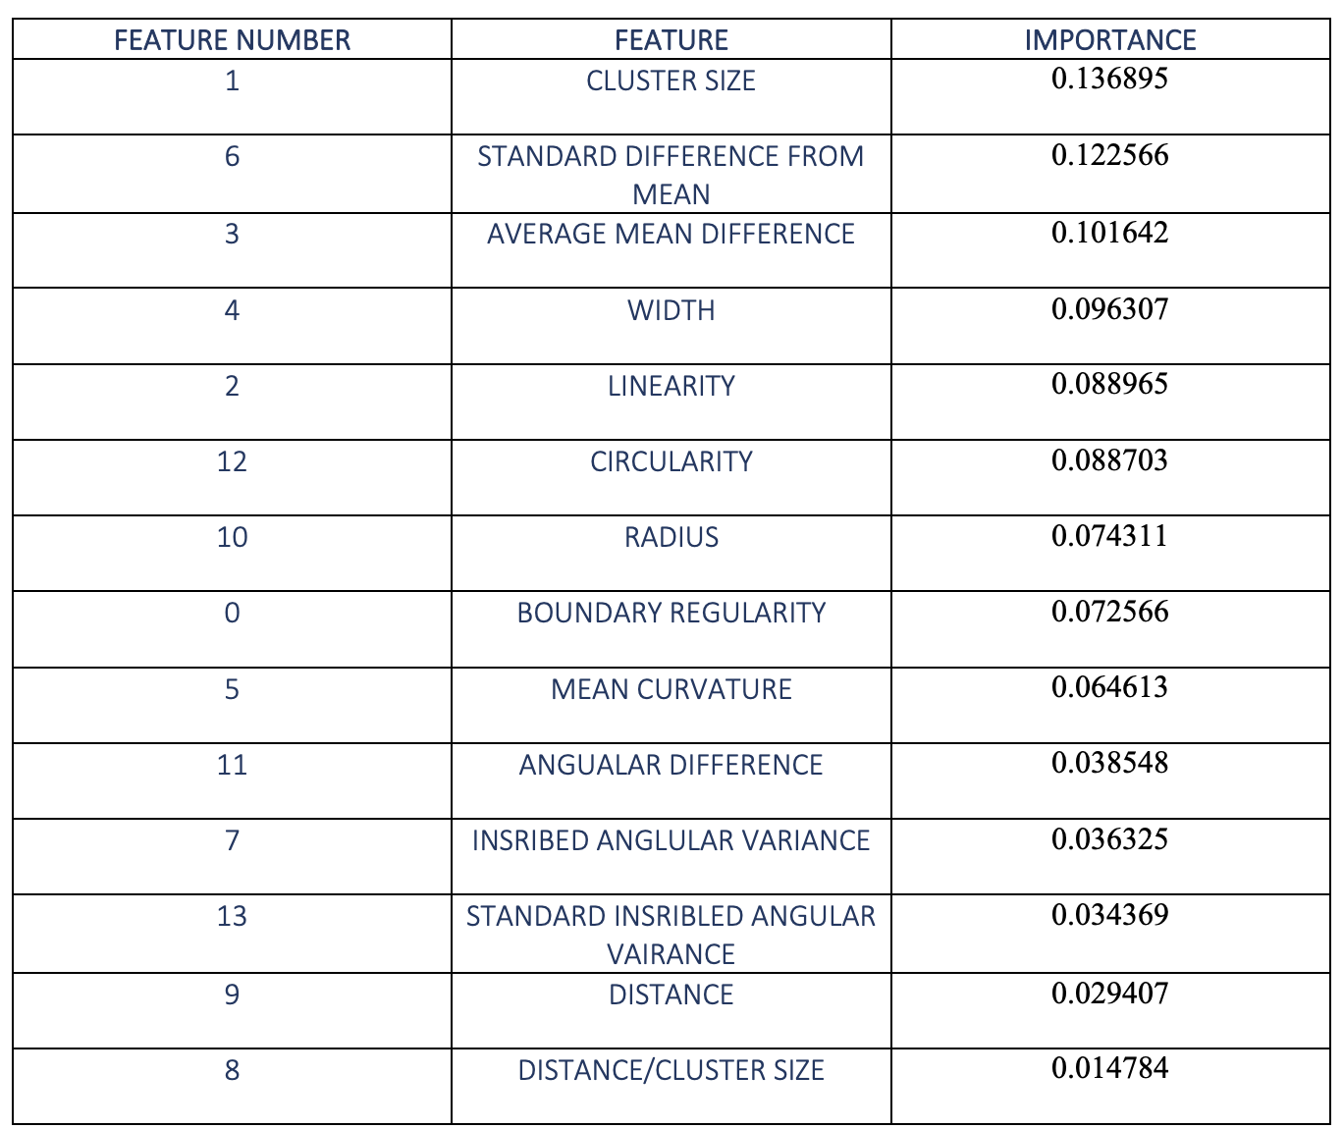
EVALUATION – FEATURE IMPORTANCE

Slide 27
EVALUATION METRICS
 | PARAMETER |  |  | Model evaluation is performed by quantifying the quality of predictions using scikit API’s.
01 | PRECISION |  | 72.50%
02 | APPLICATION DETECTION ACCURACY |  | 78.25%
03 | AUC SCORE |  | 78.08%

Slide 28
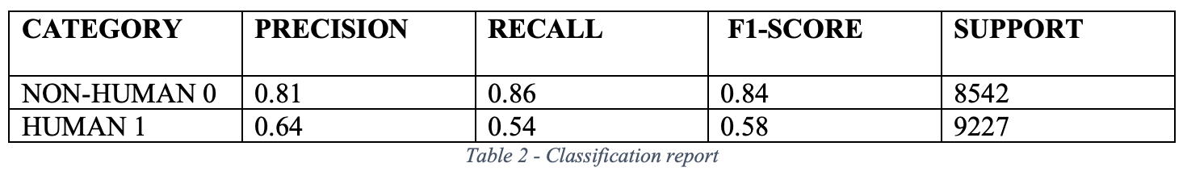
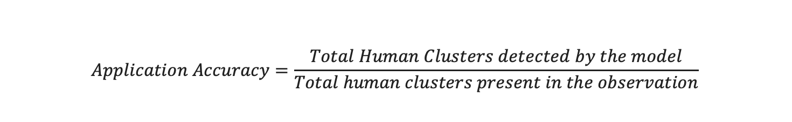
EVALUATION METRICS

Slide 29
DEMONSTRATION

Slide 30
CONCLUSION

Slide 31
CONCLUSION
FINDINGS:
Proof of concept that can be extended to other applications.
Major drawback of the project was occlusion.
False negatives and False positives decreased significantly when trained in predefined area.
Collection of positive samples was difficult and time consuming.
FUTURE SCOPE:
Use of special algorithms like Kalman to avoid occlusion.
Investigate other low power LIDAR’s.
Extend the application to clinical locomotion analysis and activity recognition.
Take advantage of cloud based machine learning tools.

Slide 32
Thank you!
ANY QUESTIONS?
Surender Sampath
ec18473@qmul.ac.uk

